Slide 1

SEMINAR PRESENTATION ON
“ HEART FAILURE PREDICTER USING DIFFERENT ML ALGORITHMS ”
SAMARTH EDUCATIONAL TRUST
ARVIND GAVALI COLLEGE OF ENGINEERING, SATARA
Presented By,
DEPARTMENT COMPUTER SCIENCE
1. SANKET YEWALE 3019
2. SAURABH KADAM 3051
3. SHRIKANT SHEJWAL 3040
4.KUNAL JIRAGE 3053
Guided By,
Dr. Varsha Bhosale Ms. Rajani Mandhare
Assistant Professor
Department of Computer Science
Arvind Gavali College of Engg., Satara
Assistant Professor
Department of Computer Science
Arvind Gavali College of Engg., Satara

Slide 2
AGENDA
Abstract
Introduction
Literature Review
Architectural Diagram
Overview of ML Technique
Dataset & its Explanation
Methodology Used
Applications
Advantages & Limitation
Result
Conclusion
Software required
Reference
Program Outcomes
Course Outcomes

Slide 3
Abstract
Cardiovascular diseases kill approximately 17 million people globally every year, and they mainly exhibit as myocardial infarctions and heart failures. Heart failure (HF) occurs when the heart cannot pump enough blood to meet the needs of the body.
Available electronic medical records of patients quantify symptoms, body features, and clinical laboratory test values, which can be used to perform biostatistics analysis aimed at highlighting patterns and correlations otherwise undetectable by medical doctors. Machine learning, in particular, can predict patients’ survival from their data and can individuate the most important features among those included in their medical records.

Slide 4
introduction
In this heart prediction project we are going to see weather the patient heart fail or not using one of the most famous algorithm called as Decision Tree Classifier in Machine Learning. In this project dataset is downloaded from UCI repository and this dataset is real. this dataset is collected one of the most famous hospital is in United Kingdom(UK) in 2015 & this dataset are uploaded in UCI repository in June 2020. in this dataset there are 299 records and 12 features(attribute) and one label.
Age, anaemia, creatinine_phosphokinase, diabetes, ejection_fraction, high_blood_pressure, platelets, serum_creatinine , serum_sodium, sex, smoking, time this all features in our dataset and label is DEATH_EVENT. Labels are represented by 0 & 1. where 1 is represented by patient is survived and 0 represent patient is not-survived.

Slide 5
Literature Review
Author Name | Year | Technology
Davide Chicco, Giuseppe Jurman | 03 February 2020 | In this paper, we analyze a dataset of 299 patients with heart failure collected in 2015. We apply several machine learning classifiers to both predict the patients survival, and rank the features corresponding to the most important risk factors. We also perform an alternative feature ranking analysis by employing traditional biostatistics tests, and compare these results with those provided by the machine learning algorithms. Since both feature ranking approaches clearly identify serum creatinine and ejection fraction as the two most relevant features, we then build the machine learning survival prediction models on these two factors alone. Link : https://doi.org/10.1186/s12911-020-1023-5
Tanvir Ahmad, Assia Munir | 20 July 2017 | survival analysis was used to estimate the survival and mortality rates. Kaplan & Meier [5] product limit estimator was used to make comparisons between survival rates at different levels explanatory variables. Cox regression was used to model mortality considering age, ejection fraction, serum creatinine, serum sodium, anemia, platelets, creatinine phosphokinase, blood pressure, gender, diabetes and smoking status as potentially contributing for mortality Link: https://doi.org/10.1371/journal.pone.0181001

Slide 6
Literature Review
Author Name | Year | Technology
SENTHILKUMAR MOHAN | 2017 | In this paper, we propose a novel method that aims at finding significant features by applying machine learning techniques resulting in improving the accuracy in the prediction of cardiovascular disease. The prediction model is introduced with different combinations of features, and several known classification techniques. We produce an enhanced performance level with accuracy level of 88.7% through the prediction model for heart disease with Hybrid Random Forest with Linear Model (HRFLM).
A. J. Aljaaf T. Dawson | 2015 | Used only Decision Tree Classifier and Data mining method predictive model shows an improvement on existing studies with 86.5% sensitivity, 95.5% specificity, and 86.53% accuracy.

Slide 7
Literature Review
Author | Year | Technology
Ashir Javeed, Sanam Shahla Rizvi | 26 August 2020 | In this paper they will use ANN and DNN classifier algorithm. From their conclusion 90%best accuracy gives the ANN algorithm. the first component of the system is a feature selection module, while the second component is a predictive model. Feature selection methods use data mining concepts to improve the performance of the machine learning models [27, 28]. the feature selection module uses a search strategy to find out the optimal subset of features.

Slide 8
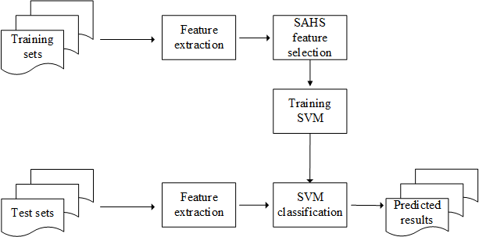
Architectural Diagram

Slide 9
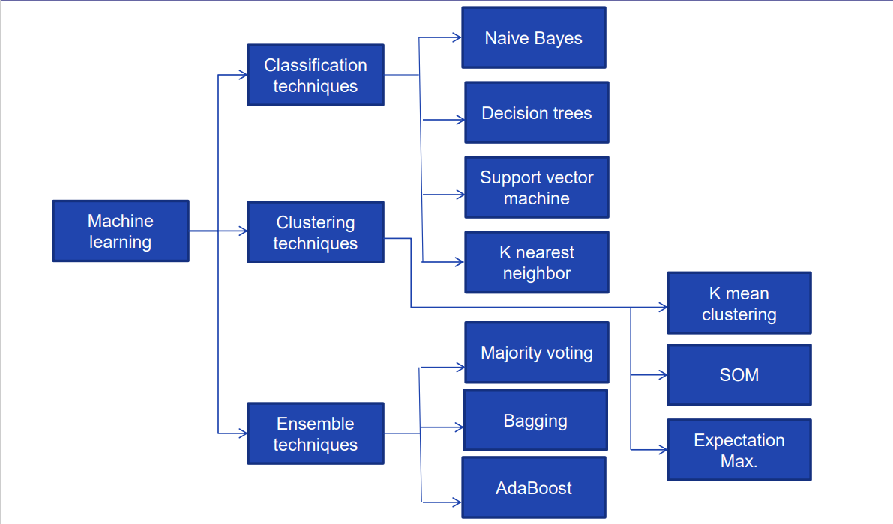
Overview of ML Technique

Slide 10
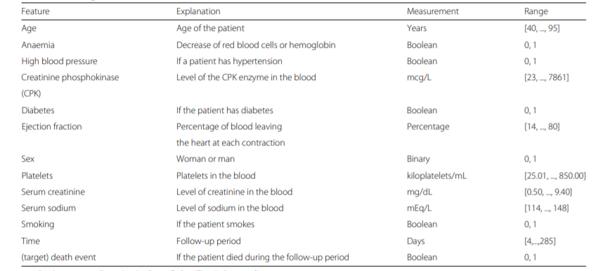
Dataset & its Explanation

Slide 11
Method
In this project, we analyze a dataset of 299 patients with heart failure collected in 2015. We apply several machine learning classifiers to both predict the patients survival, and rank the features corresponding to the most important risk factors. We also perform an alternative feature ranking analysis by employing traditional biostatistics tests, and compare these results with those provided by the machine learning algorithms. Since both feature ranking approaches clearly identify serum creatinine and ejection fraction as the two most relevant features, we then build the machine learning survival prediction models on these two factors alone.

Slide 12
method
This project is based on machine learning classification. There are two types of classification one is Binary class classification and other is Multiclass classification so our project is based on Binary Class Classification. Weather patient is survived or not (1 & 0).
There are many algorithms to solve classification problem like Decision Tree, KNN, random forest classifier but here we use decision tree. So decision tree it means simple graph without circuit and the main part of the decision tree is the Root node, internal node and leaf node(labels).
First one to install scikit learn (sklearn) packages and collect the dataset weather is in UCI repository, kaggel or github this three platform we are able to download or collect the datsets.
In jupyter notebook import the datasets and check the information about datasets weather the any missing values is there or not. Then describe the datasets.

Slide 13
method
Next we correlate our datasets by using Pearson correlation coefficient
Calculate mean and standard deviation.
Drawing the histography for all attributes or features.
See our target and drop that target column because if we are not drop the target table the machine can view our target the machine overfitted that target in that case accuracy is high but when coming new record the machine are not able to classify correctly that’s why we drop target table in our dataset target is last column i.e., DEATH_EVENT this is our target.
calculate the count for each target class
Analysing all attributes with the help of graphs.

Slide 14
method
Slicing the data or splitting the data. Here to split data for training and testing so in our dataset there are 299 records of patients. We use 250 out of 299 for training and other(49) records for testing. Same like that also split the target.
Train the model by using Decision Tree Classifier from machine learning.
Then calculate the mean squared error it means difference of actual minus predicted by using mean_squared_error().
Test the model.
Also calculate the Confusion Matrix, Precision, Recall, f1-score or f-Measure and accuracy of the model.

Slide 15
advantages
Save time
Web based application
Free of Cost
Use Anytime anywhere

Slide 16
disadvantages
Network Connection
Some technical problem
It Needs to know the features

Slide 17
Limitations
More complex methods can be employed to improve accuracy
Majority voting is the simplest way of combining predictions

Slide 18
Result
Our results of these two-feature models show not only that serum creatinine and ejection fraction are sufficient to predict survival of heart failure patients from medical records, but also that using these two features alone can lead to more accurate predictions than using the original dataset features in its entirety. We also carry out an analysis including the follow-up month of each patient: even in this case, serum creatinine and ejection fraction are the most predictive clinical features of the dataset, and are sufficient to predict patients’ survival.

Slide 19
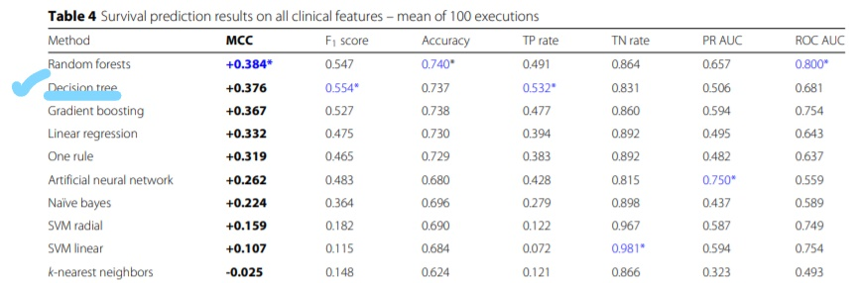
Result

Slide 20
Result
The Decision Trees obtained the top results on the true positives (sensitivity = 0.532) and on the F1 score (0.554), and was the only classifier able to predict correctly the majority of deceased patients.

Slide 21
Conclusion
This discovery has the potential to impact on clinical practice, becoming a new supporting tool for physicians when predicting if a heart failure patient will survive or not. Indeed, medical doctors aiming at understanding if a patient will survive after heart failure may focus mainly on serum creatinine and ejection fraction.

Slide 22
Software required
Python 3.0
Jupyter Notebook
Sklearn packages
Pandas
Anaconda

Slide 23
Reference
Davide Chicco, Giuseppe Jurman: "Machine learning can predict survival of patients with heart failure from serum creatinine and ejection fraction alone". BMC Medical Informatics and Decision Making 20, 16 (2020). [Web Link]
Ahmad T, Munir A, Bhatti SH, Aftab M, Raza MA (2017) Survival analysis of heart failure patients: A case study. PLoS ONE 12(7): e0181001. https://doi.org/10.1371/journal. pone.0181001
SENTHILKUMAR MOHAN1 , CHANDRASEGAR THIRUMALAI2 , AND GAUTAM SRIVASTAVA3,4 (Member, IEEE) . Citation information: DOI 10.1109/ACCESS.2019.2923707, IEEE Access

Slide 24
Reference
A. J. Aljaaf, 1 D. Al-Jumeily, 1 A. J. Hussain, 2 T. Dawson, 1 P Fergus and 3 M. Al-Jumaily 1 Applied Computing Research Group, Liverpool John Moores University, Byrom Street, Liverpool, L3 3AF, UK Proceedings of The Third International Conference on Technological Advances in Electrical, Electronics and Computer Engineering, Beirut, Lebanon 2015 https://www.researchgate.net/publication/285576019
Ashir Javeed,1 Sanam Shahla Rizvi , 2 Shijie Zhou,1 Rabia Riaz,3 Shafqat Ullah Khan,4 and Se Jin Kwon School of Information and Software Engineering, University of Electronic Science and Technology of China (UESTC), Chengdu, China, Received 16 March 2020; Revised 4 May 2020; Accepted 29 July 2020; Published 26 August 2020. , https://doi.org/10.1155/2020/8843115

Slide 25

Program outcomes

Slide 26
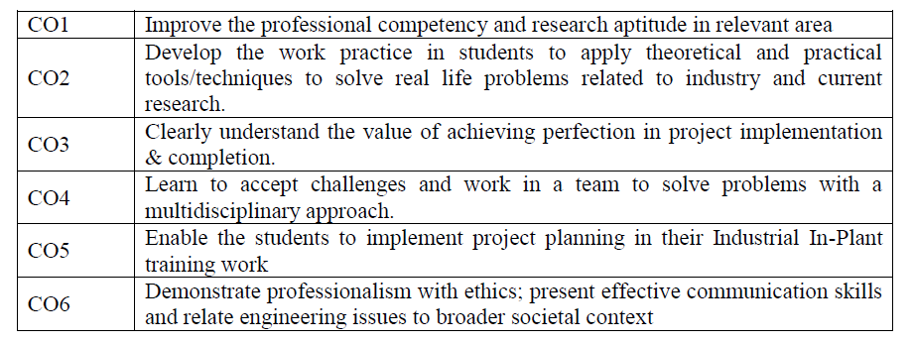
Course outcomes

Slide 27
Any Queries…….?

Slide 28
THANK YOU

